Slide 1
PYTHON TEAM PROJECT
SUBJECT CODE : INT-213
SUBJECT TEACHER : P. RAJA SIR
TEAM MEMBERS : 2
PROJECT TOPIC : MORSE CODE TRANSLATOR

Slide 2
MEMBER 1 : HUDA SAIF MANSOOR REG. NO : 12019037 ROLL NO : RK20YRB70
MEMBER 2: SUBRAT KESHARI SAHU REG. NO : 12020245 ROLL NO : RK20YRB56

Slide 3
WHAT IS MORSE CODE?
The term Morse Code refer to either of two systems for representing letters of the alphabet, numerals and punctuation marks by an arrangement of dots, dashes and spaces. The codes are transmitted as electrical pulses of varied lengths or analogues mechanical or visual signals, such as flashing lights.

Slide 4
IMPORTANCE OF MORSE CODE
Looking back in our history , Morse Code has played a vital role of communication between 2 units separated from each other at a great distance. It was observed that this invention led to a resolution in which many conflicts among nations and countries were brought down to peace during the era of war.
Morse Code allowed for ships at sea to communicate over long distances using large lights. Morse Code was especially pivotal during the second World War because it greatly improved the speed of communication. Naval war ships were able to communicate with their bases and provide critical information to each other. War planes also used Morse Code to detail locations for enemy ships, bases, and troops and relay them back to headquarters.

Slide 5
ENCRYPTION
In the case of encryption, we extract each character (if not space) from a word one at a time and match it with its corresponding Morse code stored in whichever data structure we have chosen.
Store the Morse code in a variable that will contain our encoded string and then we add a space to our string that will contain the result.
While encoding in Morse code we need to add 1 space between every character and 2 consecutive spaces between every word.
If the character is a space, then add another space to the variable containing the result. We repeat this process till we traverse the whole string.

Slide 6
DECRYPTION
In the case of decryption, we start by adding a space at the end of the string to be decoded .
Now we keep extracting characters from the string till we are not getting any space.
As soon as we get a space, we look up the corresponding English language character to the extracted sequence of characters and add it to a variable that will store the result.
Remember keeping track of the space is the most important part of this decryption process. As soon as we get 2 consecutive spaces, we will add another space to our variable containing the decoded string.
The last space at the end of the string will help us identify the last sequence of Morse code characters.

Slide 7
IMPLEMENTATION
Python provides a data structure called dictionary which stores information in the form of key value pairs which is very convenient for implementing a cipher such as a Morse code. We can save the Morse code chart in a dictionary .
The plaintext in English characters takes the place of keys and the cipher text i.e., Morse code forms the values of the corresponding keys.
The values of keys can be accessed from the dictionary in the same way we access the values of an array through their index and vice versa.

Slide 8
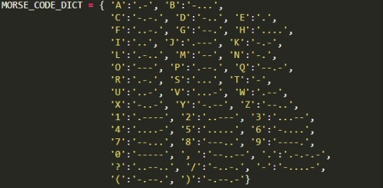
MORSE CODE DICTIONARY IN PYTHON

Slide 9
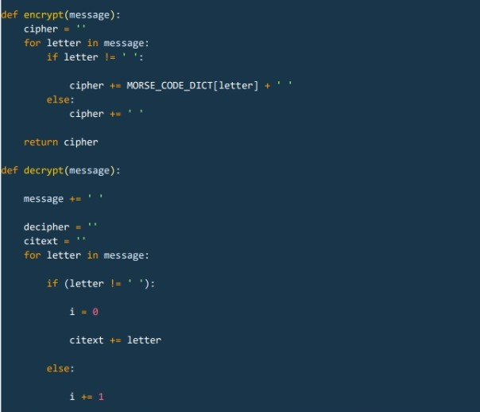
CODE OF EXECUTION (1/2)

Slide 10
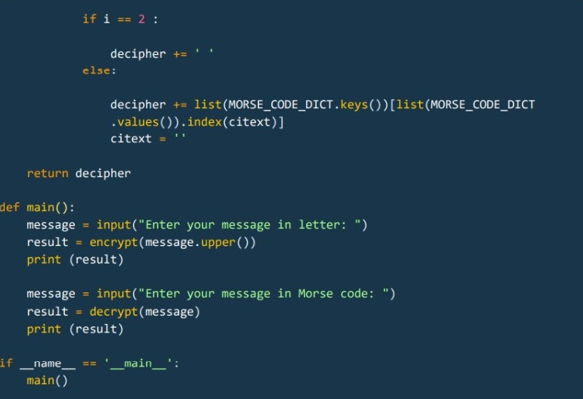
CODE OF EXECUTION (2/2)

Slide 11
Words to Morse Code Execution

Slide 12
Morse Code to Words Execution

Slide 13
CONCLUSION
We would like to conclude by stating that as all of us know that Python language and the Morse Code are highly appreciated in their very respective fields, so by combining both we can create a very efficient method to both implement python and communicate via Morse Code.
In todays fast moving and adapting world we all focus on the things with better efficiency in order to achieve our respective goals. Python being an easy language to learn can be used to create messages and signals that can be transmitted through the channel of Morse Code.
The topic for this project was precisely selected to enlighten the use of Python language with our Modern History’s tools that are evergreen namely Morse Code.

Slide 14
THANK YOU

